Slide 1
SQL PROJECT –
HOST BEHAVIOR ANALYSIS FOR PROPERTY RENTAL COMPANY

Slide 2

Introduction
I have done an Analysis for a Property Rental company. In this analysis I have shown how Host Behaviour varies across variety of metrics. Had understood the data and came up with the below analysis:
a. I have Analysed different metrics to draw the distinction between Super Host and Other Hosts:
To achieve this, I have used the following metrics.
Acceptance rate, Response rate, Instant booking, Profile picture, Identity verified, Review scores, Average no of bookings per month.
b. Using the above analysis, I have identified top 3 crucial metrics one needs to maintain to become a Super Host and also, found out their average values.
c. Analysed how does the comments of reviewers vary for listings of Super Hosts vs Other Hosts.
d. Analysed do Super Hosts tend to have large property types as compared to Other Hosts.
e. Analysed Average price and Availability of the listings for the upcoming year between Super Hosts and Other Hosts
f. Analysed if there is some difference in above mentioned trends between Local Hosts or Hosts residing in other locations.
g. Analysed the above trends for the two cities and provided insights on Comparison.

Slide 3
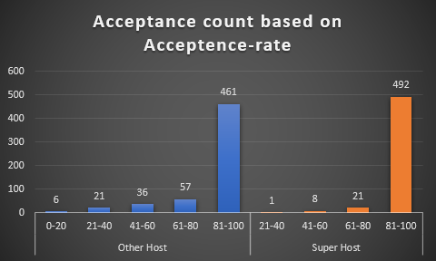
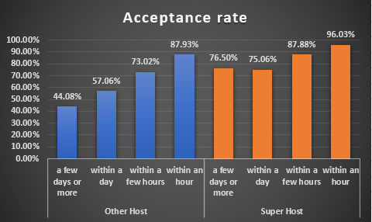
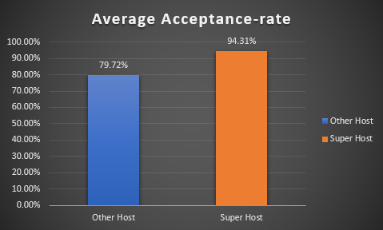
Acceptance Rate
In the first plot I have shown the counts of Super and Other Hosts based on the different Acceptance Rate.
In the second plot I have shown Average Acceptance rate of both the hosts, for Super Hosts it is very High.
In the third plot I have shown the Acceptance rate based on the Response Time.

Slide 4
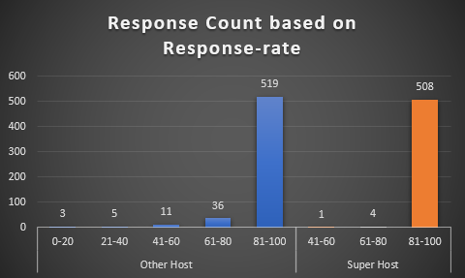
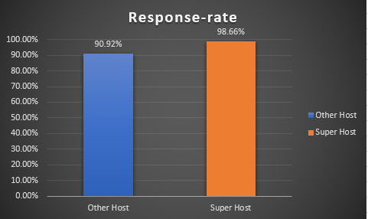
Response Rate
In the first bar plot I have shown Host’s Response count based on Different Response Rate.
In the second bar plot shown the Average Response Rate for the Super & Other Hosts.

Slide 5
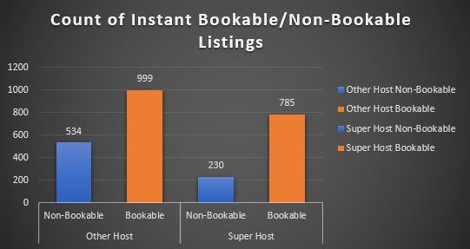
Instant Booking
In this bar plot I have shown the count of Instant Bookable/Non-Bookable Listings based on Super Host and Other Host

Slide 6
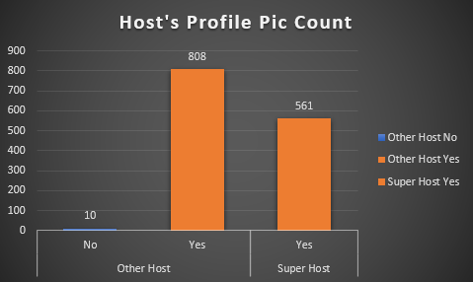
Profile Pic
In this bar plot I have shown how many Super Hosts and Other Hosts have Profile Pic or not, and it is visible that all the Super Hosts are having Profile Pic.

Slide 7
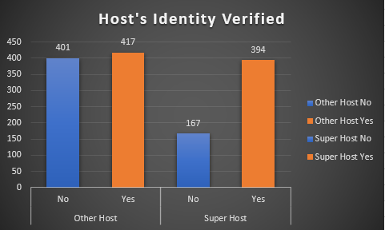
Identity Verification
In this bar plot I have shown how many Super hosts and Other hosts have their Identity verified or not.

Slide 8
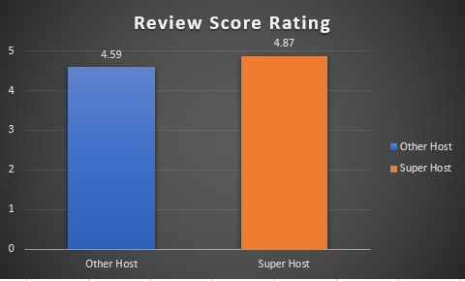
Review Score
In this bar plot I have shown the Average Review Rating for Both Super Hosts and Other Hosts.

Slide 9
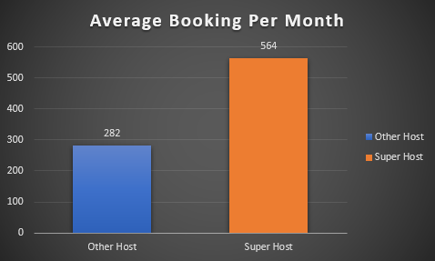
Average Booking Per month
In this plot I have shown the Average Booking per month for Super Hosts and Other Hosts and it is visible in the plot that the Super Host’s Average Booking per month is very high as compared to Other Hosts.

Slide 10
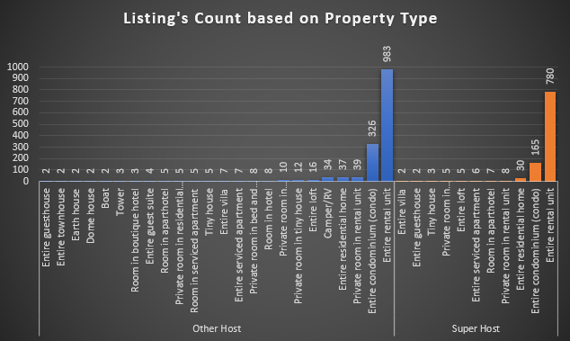
Size of Property
I this bar plot I have shown how many different types of properties both the hosts are having and in the bar plot it is visible that Super Hosts are not having large properties types as compared to Other Hosts.

Slide 11
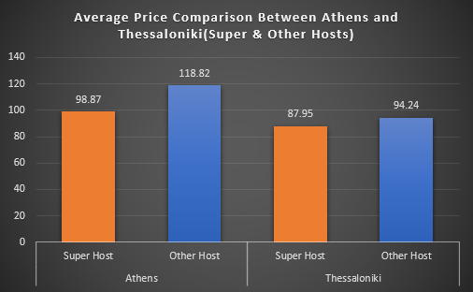
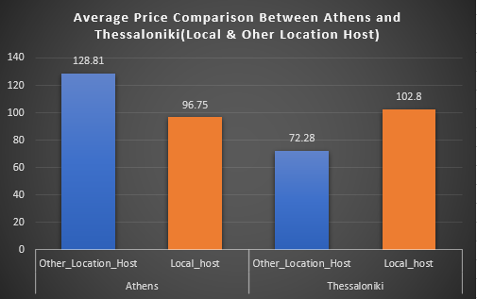
Average Price Comparison
In this plot I have shown the Average Price comparison for both the cities Athens and Thessaloniki and further it is divided into (Super & Other hosts) and (Local and Other Location Hosts).

Slide 12
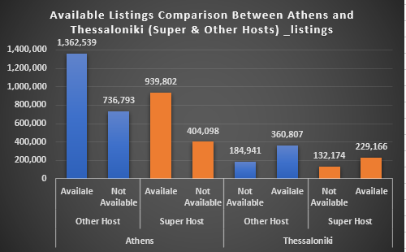
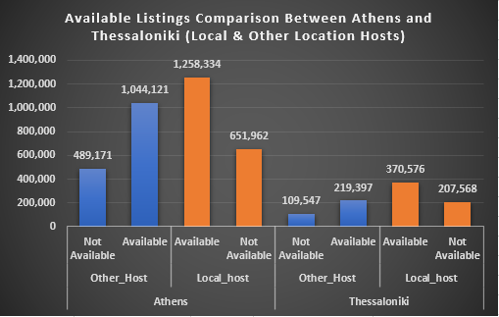
Available Listings
In this plot I have shown the Average Price comparison for both the cities Athens and Thessaloniki and further it is divided into (Super & Other hosts) and (Local and Other Location Hosts).

Slide 13
3 crucial metrics one needs to maintain to become a Super Host
1. We can see from the below chart that the Average Acceptance rate of Super Host and Other Host have a difference of around 15% so, it could be a crucial metric to become a Super Host, Like one should have a High Acceptance rate to become a Super Host.
2.We can see from the below chart that the Response Rate is also high for the Super Host here, it could also be a crucial metric to become a Super Host, One should have a high Response rate.
3.We can see from the below chart that the Average booking per month is much higher for the Super host, it could be definitely a crucial metric to become a Super Host, One should have a Higher Booking per month.

Slide 14
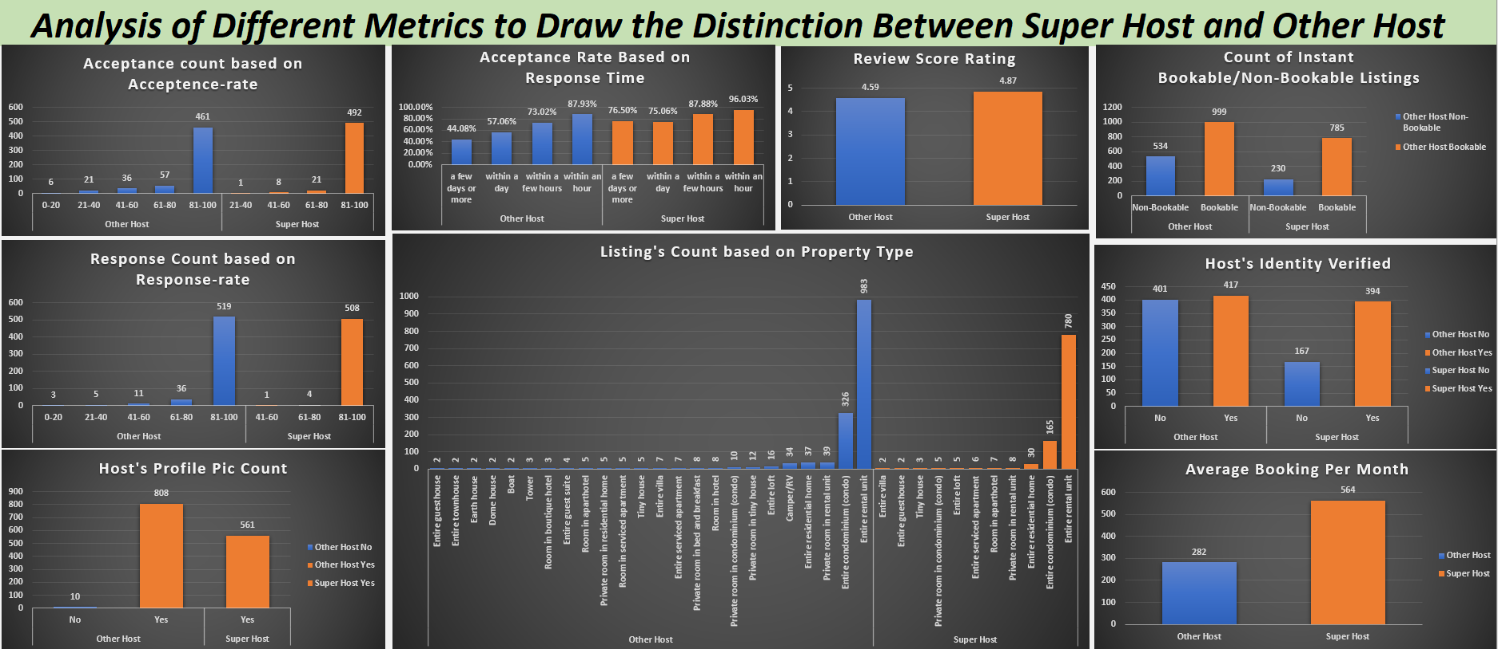

Slide 15
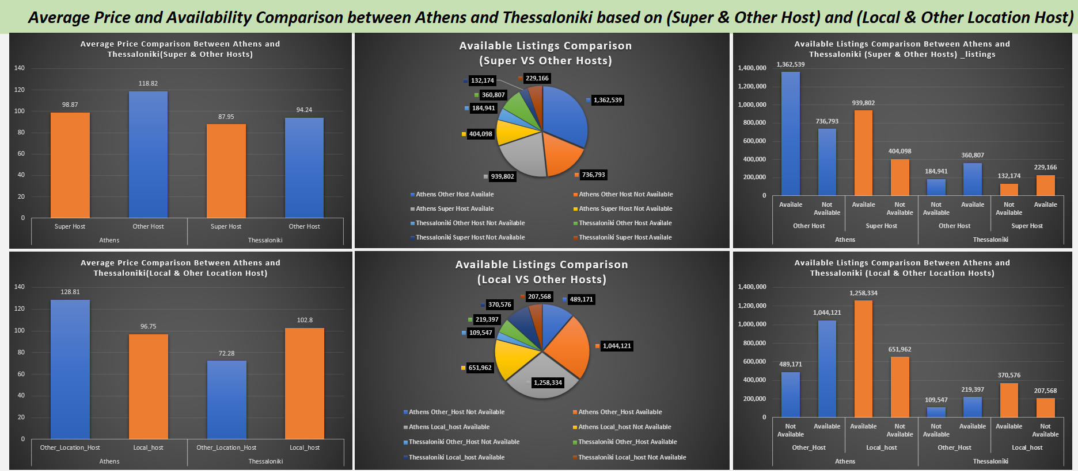

Slide 16
Thank You!!!

